Slide 1
Low Level Network Attacks
CSE 405 January 2025 - Lecture 5
Special Thanks to Peyrin Kao (UC Berkeley)

Slide 2
Today: Low-Level Network Attacks
Network Attackers
Man-in-the-middle attacker
On-path attacker
Off-path attacker
ARP: Translate IP addresses to MAC addresses
WPA: Communicate securely in a wireless local network
DHCP: Get configurations when first connecting to a network

Slide 3

Network Attackers
Notes:
5 min - 12:45
Let’s define who the attackers are. What is our threat model?
Without a threat model, who’s to say we don’t have attackers–then we don’t care about security!

Slide 4
Types of Network Attackers
Threat model: There are 3 types of attackers we’ll consider
 | Can modify or delete packets | Can read packets | Can inject spoofed packets
Man-in-the-middle attacker | ✓ | ✓ | ✓
On-path attacker |  | ✓ | ✓
Off-path attacker |  |  | ✓
Notes:
These attackers model real life
MITM like crypto
Off-path attacker may seem useless
Blind SQL injection still works -> similar concept in networking (although may actually be easier)

Slide 5
Spoofing
Anybody can send their own packets through the network
Spoofing: Lying about the identity of the sender
Example: Mallory sends a message and says the message is from Alice
The attacker can lie about the source address in the packet header
All types of attackers can spoof packets
However, some spoofing attacks may be harder if the attacker can’t read or modify packets
Notes:
This is why we care about off-path attackers!
Even though off-path can’t read/modify, they can still send their own packets (pretending to be another user)
Haven’t talked about exactly what a packet contains but surely contains who it’s from and who it’s to (this doesn’t need to be honest)
Mallory can lie! Not “From: Mallory”, could say something like “From: Bob”...
In practice, whether an attacker can spoof kind of depends
We’ll see some protocols later that will make it harder to spoof!

Slide 6
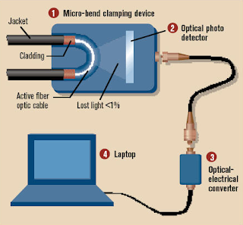
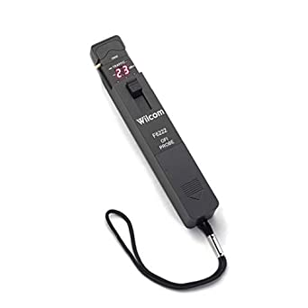
Real-World On-Path Attackers
How might a real-life attacker read packets?
Layer 1 attack: Use a special device to read bits being transmitted across space
Notes:
Layer 1: Physical Layer - Encodes bits to send them over a physical link
This capability is modeled by an on-path attacker

Slide 7

Real-World On-Path Attackers
Operation Ivy Bells
Matthew Carle | February 6, 2017
In an effort to alter the balance of the Cold War, divers from the USS Halibut scoured the ocean floor for a five-inch diameter cable that carried secret Soviet communications between military bases. The divers found the cable and installed a listening device. Upon their return to the United States, the NSA analyzed the recordings and found that a surprising amount of sensitive Soviet information travelled through the lines without encryption. The original tap was later discovered by the Soviets and is now on exhibit at the KGB museum in Moscow.
Notes:
https://www.military.com/history/operation-ivy-bells.html
Can spy on the thick underwater cables using a listening device

Slide 8
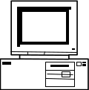
Real-World On-Path Attackers
Layer 2 attack: Read packets sent across the local area network (LAN)
Recall: A LAN is a network of connected machines
Any machine on the LAN can send packets to any other machine on the LAN
Some LANs use broadcast technologies
Every packet gets sent to every machine on the LAN
Each machine agrees to ignore packets where the destination is a different machine
A machine can break the agreement and read packets meant for other machines
This is called promiscuous mode
May require root access on the machine
A
B
C
D
Notes:
Layer 2 - Link Layer
Encodes messages into groups of bits called “frames”
Another on-path attacker
Broadcast: connects everyone in the LAN together (everyone gets your message in the LAN)
There’s a single wire connecting everybody
How do you know who the packet is for? Sender/receiver (to/from)
Non-malicious people would just ignore packets not meant for them
But there’s nothing stopping you from breaking this agreement…
You could peek!
On a hardware level, you are going to be receiving those bits, now you’re just overriding the check to read them
Most of the time, due to broadcast, we’ll assume people in LAN are on-path (they can read these messages)

Slide 9
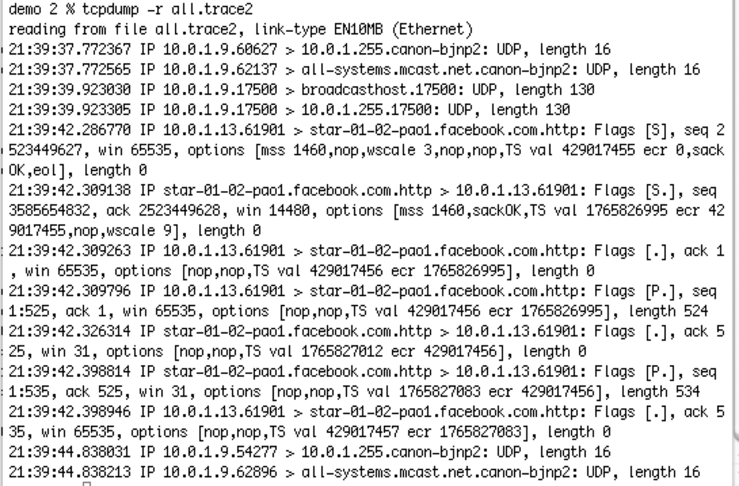
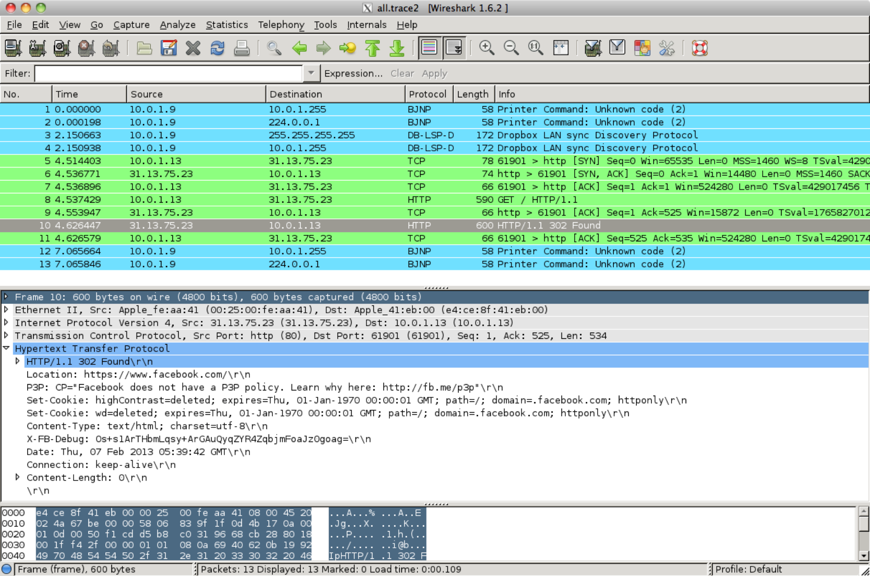
Real-World On-Path Attackers
tcpdump: A program for reading packets on the local network
Uses promiscuous mode to read other machines’ packets in broadcast technologies
Wireshark: A graphical user interface (GUI) for analyzing tcpdump packets
Notes:
You can check out all the packets sent over the network
Sniff packets that weren’t meant for you
Tcpdump: terminal, graphic: wireshark
Not really legal unless you have permission from people in the network

Slide 10
Real-World On-Path Attackers
Some layer 2 (Ethernet) devices can be configured to also send a copy of every packet to the attacker
The attacker could also use this device to modify packets (man-in-the-middle attack)
Example: DualComm DCGS-2005
Newer model: ETAP-2003R
Cost: $200
Powered with USB (no extra power supply needed)
Alice
To: Bob
“Hi”
Ethernet Device
To: Bob
“Hi”
To: Bob
“Hi”
Attacker
Bob
Notes:
There’s a lot of different ways for being on-path attackers!
Security is economics – is listening and modifying messages on this network worth $200 to you?

Slide 11
Address Resolution Protocol (ARP)
Notes:
10 min - 1:50
First protocol in networking :)

Slide 12
Review: Layer 2 and Layer 3
Local area network (LAN): A set of machines connected in a local network
The MAC address identifies devices on layer 2
Internet (IP): Many LANs connected together with routers
The IP address identifies devices on layer 3
A
B
C
D
Router
E
F
G
H
Notes:
Layer 2: hardware MAC addresses baked into a computer (not the same MAC as in crypto)
Identifies addresses in the local network
Layer 3: IP addresses identify computers across the world
MAC address is responsible for local identification, IP address for global identification
Well, how do we translate between them?

Slide 13
Address Resolution Protocol (ARP)
ARP: Translates layer 3 IP addresses to layer 2 MAC addresses
Example: Alice wants to send a message to Bob on the local network, but Alice only knows Bob’s IP address (1.2.3.4). To use layer 2 protocols, she must learn Bob’s MAC address.
Steps of the protocol
Alice checks her cache to see if she already knows Bob’s MAC address.
If Bob’s MAC address is not in the cache, Alice broadcasts to everyone on the LAN: “What is the MAC address of 1.2.3.4?”
Bob responds by sending a message only to Alice: “My IP is 1.2.3.4 and my MAC address is ca:fe:f0:0d:be:ef.” Everyone else does nothing.
Alice caches Bob’s MAC address.
Notes:
If I only know Bob’s IP address (not MAC address), I get trapped!
Can’t send the message -> can’t use layer 2 protocols like ethernet
We need to be able to translate this
Walk through the steps !
Broadcast: you’re telling the entire LAN
Everyone’s connected over one wire
In Step 3: everyone hears and chooses to ignore
They see the packet says “To: Bob”

Slide 14
Address Resolution Protocol (ARP)
Alice knows Bob’s IP address (1.2.3.4) but wants to learn Bob’s MAC address.
Bob
Charlie
Alice’s cache
IP | MAC
Alice
Dave
Router
1. Alice checks her cache to see if she already knows the MAC address corresponding to 1.2.3.4.
Since her cache is empty, she must make a request to find out.
Notes:
Goal: Translate Layer 3 IP addresses into Layer 2 MAC addresses
Cache for optimization!

Slide 15
Address Resolution Protocol (ARP)
Alice knows Bob’s IP address (1.2.3.4) but wants to learn Bob’s MAC address.
Bob
Charlie
Alice’s cache
IP | MAC
Alice
Dave
Router
2. Alice asks everyone else on the local network: “What is the MAC address of 1.2.3.4?”

Slide 16
Address Resolution Protocol (ARP)
Alice knows Bob’s IP address (1.2.3.4) but wants to learn Bob’s MAC address.
Bob
Charlie
Alice’s cache
IP | MAC
Alice
Dave
Router
3. Bob responds: “My IP is 1.2.3.4 and my MAC address is ca:fe:f0:0d:be:ef.”
Everybody else ignores the request.

Slide 17
Address Resolution Protocol (ARP)
Alice knows Bob’s IP address (1.2.3.4) but wants to learn Bob’s MAC address.
Bob
Charlie
Alice’s cache
IP | MAC
1.2.3.4 | ca:fe:f0:0d:be:ef
Alice
Dave
Router
4. Alice adds Bob’s MAC address to her cache.

Slide 18
Address Resolution Protocol (ARP)
If Bob is outside of the LAN, the router will respond with its own MAC address
If Alice wants to send a packet to Bob, she sends the packet to the router
The router can forward the packet to other LANs to reach Bob
Alternatively, if Alice knows what addresses belong to the LAN, she will request the MAC address that corresponds to the router’s IP
All received ARP replies are cached, even if no request was sent
From: 20:61:84:3a:a9:52
To: 6d:36:ff:4a:32:92
To: Router’s MAC address
From: 1.2.3.4
To: 5.6.7.8
Layer 2: Ethernet
From: Port 1234
To: Port 80
To: Bob’s IP address
Layer 3: IP
GET / HTTP/1.1
...
Notes:
Bob outside LAN, the layer 3 packet will be addressed to Bob, but Layer 2 to Router
Layer 2 packet wraps around Layer 3 packet
Intuition: Pre-phone era, if I needed to get a message to my friend in Seattle. I can’t drive there–she’s not locally here. I drop it off at the post office and trust they’ll get it to her.
Layer 2: the Bay area (where I can drive)
Layer 3: USPS needs to do the routing (BGP!)
“You want this person? They don’t live in this area”
The router understands zip codes (like subnets) and knows how to route it to the right place
Sometimes no request is needed
Bob will just randomly broadcast “My IP address is X, here’s my corresponding MAC addresses”
Most people will cache that
Kind of strange, might be malicious…?

Slide 19
Attacks on ARP
Alice knows Bob’s IP address (1.2.3.4) but wants to learn Bob’s MAC address.
Bob
Charlie
Alice’s cache
IP | MAC
Alice
Mallory
Router
1. Alice checks her cache to see if she already knows the MAC address corresponding to 1.2.3.4.
Since her cache is empty, she must make a request to find out.
Notes:
Step 1 stays the same

Slide 20
Attacks on ARP
Alice knows Bob’s IP address (1.2.3.4) but wants to learn Bob’s MAC address.
Bob
Charlie
Alice’s cache
IP | MAC
Alice
Mallory
Router
2. Alice asks everyone else on the local network: “What is the MAC address of 1.2.3.4?”
Notes:
Step 2 stays the same
Pause & ask
Who else can answer?

Slide 21
Attacks on ARP
Alice knows Bob’s IP address (1.2.3.4) but wants to learn Bob’s MAC address.
Bob
Charlie
Alice’s cache
IP | MAC
Alice
Mallory
Router
3. Before Bob’s response can arrive, Mallory sends a malicious response: “My IP is 1.2.3.4 and my MAC address is 66:66:66:66:66:66.”
Notes:
Lie about IP address (this is Bob’s IP), be say Mallory’s MAC address
If Alice hears this first, she’ll cache this first

Slide 22
Attacks on ARP
Alice knows Bob’s IP address (1.2.3.4) but wants to learn Bob’s MAC address.
Bob
Charlie
Alice’s cache
IP | MAC
1.2.3.4 | 66:66:66:66:66:66
Alice
Mallory
Router
4. Alice adds Mallory’s malicious address to her cache.
Notes:
Anytime Alice wants to send a message to Bob, it will now go to Mallory (yikes)

Slide 23
Attack: ARP Spoofing
Alice has no way of verifying the ARP response
Spoofing: Any attacker on the local network can claim to have the requested IP address
Alice is only expecting one machine to respond, so she will accept the first response
Race condition: As long as the attacker responds faster, the requester will accept the attacker’s response
ARP spoofing requires Mallory to be in the same LAN as Alice
ARP spoofing lets Mallory become a man-in-the-middle (MITM) attacker
Alice thinks that Bob’s MAC address is 66:66:66:66:66:66 (Mallory’s MAC address)
When Alice sends a message to Bob, she is actually sending the message to Mallory
Mallory can modify the message and then send the modified message to Bob
Notes:
20 min - 1:00
No way to verify response – there’s no security (yet)! -> no cryptography (no signatures, etc.)
Alice only broadcasts to the LAN so Mallory has to be in the LAN
Connected by the wires
Mallory is originally just an on-path attacker -> she only needs to hear Alice’s broadcast
Then, she gets upgraded to MITM
Think of DHE!

Slide 24
ARP Spoofing: Defenses
Use switches to avoid broadcasts and ARP requests
When Alice wants to send a message to Bob, she sends the message to a switch on the LAN
The switch maintains a cache of IP/MAC mappings
Since everyone is using the switch, its cache is larger than an individual user’s cache
If Bob’s MAC address is in the cache, the switch sends the message directly to Bob
Otherwise, the switch broadcasts the message
Benefits of switches
Security: Reduces the number of messages broadcast to the entire LAN
Efficiency: Fewer broadcast requests means more requests can be sent per second
Isolation: Smarter switches implement virtual local area networks (VLANs), which split a LAN into several isolated parts
One part of the VLAN cannot directly interact with other parts of the VLAN
Tools like arpwatch track ARP responses and make sure that there is no suspicious activity
Notes:
[hardware-level fix] Switch is a server on the network or maybe even the router
Sole job is to maintain IP<>MAC mappings
Instead of broadcasting, you just send the message directly to the switch (unicast)
If switch knows, switch directly sends the message to Bob
Otherwise, broadcast the message to everyone
Less likely to spoof -> larger cache, less broadcasts
VLANs broadcast within VLANs
Why virtual? -> Technically still one LAN
Why? Maybe you’re at the dentist: split your own WiFi and guest WiFi
Arpwatch is a software level fix -> sit on the network and can detect
Two responses that came in? Weird
One computer keeps answering for everything else… also weird
These aren’t perfect -> upper layers will provide more security

Slide 25
Dynamic Host Configuration Protocol (DHCP)
Notes:
25 min - 1:05
Done with first protocol! Now you can say you know (A)ARP!

Slide 26
DHCP: Initial Network Configuration
To connect to a network, a user needs:
An IP address so that other people can contact the user
The IP address of the DNS server (we’ll see this soon)
The IP address of the router (gateway) so that the user can contact machines outside of the LAN
The first time a user connects, they don’t have this information yet
The user also doesn’t know who to ask for this information
DHCP gives the user a configuration when they first join the network
Notes:
How do we set up when you first connect to the network?
Post office: set up your mailing address, figure out where your nearest post office is to deliver mail
Post office is a router
DNS: domain name -> IP address
Address book lookup
You know who you want to send it to (ie: google.com, but you don’t know the address)

Slide 27
Steps of the DHCP Handshake
Client Discover: The client broadcasts a request for a configuration
DHCP Offer: Any DHCP server can respond with a configuration offer
Usually only one DHCP server responds
The offer includes an IP address for the client, the DNS server’s IP address, and the (gateway) router’s IP address
The offer also has an expiration time (how long the user can use this configuration)
Client Request: The client broadcasts which configuration it has chosen
If multiple DHCP servers made offers, the ones that were not chosen discard their offer
The chosen DHCP server gives the offer to the client
DHCP Acknowledgement: The chosen server confirms that its configuration has been given to the client
Notes:
You don’t know who to ask (so you broadcast to LAN)
In theory, multiple people can respond
Unchosen ones can be discarded (and used for other people)
Like a confirmation email

Slide 28
Dynamic Host Configuration Protocol (DHCP)
Bob
DHCP Server 1
Alice’s configuration
My IP | ???
DNS Server | ???
Gateway | ???
Alice
DHCP Server 2
Router
Alice wants to connect to the network, but she’s missing a configuration.

Slide 29
Dynamic Host Configuration Protocol (DHCP)
Bob
“Can anyone give me a configuration?”
DHCP Server 1
Alice’s configuration
My IP | ???
DNS Server | ???
Gateway | ???
Alice
DHCP Server 2
Router
1. Client Discover: Alice broadcasts a request for a configuration.

Slide 30
Dynamic Host Configuration Protocol (DHCP)
Bob
“You can use IP x, DNS server y, and gateway z”
DHCP Server
Alice’s configuration
My IP | ???
DNS Server | ???
Gateway | ???
Alice
“You can use IP a, DNS server b, and gateway c”
DHCP Server
Router
2. DHCP Offer: Any DHCP server can reply with an offer for Alice.

Slide 31
Dynamic Host Configuration Protocol (DHCP)
Bob
“I’ll use DHCP Server 1”
DHCP Server 1
Alice’s configuration
My IP | ???
DNS Server | ???
Gateway | ???
Alice
DHCP Server 2
Router
3. Client Request: Alice broadcasts which configuration she has chosen.

Slide 32
Dynamic Host Configuration Protocol (DHCP)
Bob
Reserved for Alice: IP x, DNS y, gateway z
DHCP Server 1
Alice’s configuration
My IP | x
DNS Server | y
Gateway | z
Alice
DHCP Server 2
Router
4. DHCP Acknowledgement: The chosen DHCP server confirms that the configuration has been set for Alice.

Slide 33
DHCP Attacks
Alice has no way of verifying the DHCP response
Spoofing: Any attacker on the local network can claim to have a configuration
Alice usually expects only one DHCP server to respond, so she will accept the first response
Race condition: As long as the attacker responds faster, Alice will accept the attacker’s response
DHCP attacks require Mallory to be in the same LAN as Alice
DHCP attacks let Mallory become a man-in-the-middle (MITM) attacker
Mallory claims the gateway router’s address is Mallory’s address
When Alice tries to send a message to the rest of the Internet, she actually sends it to Mallory
Mallory can modify the message before sending it to its destination
Mallory can also claim the DNS server’s address is Mallory’s address
Notes:
Felt similar to ARP right? So it has similar attacks as well
No crypto, etc.
In general, accepts first one (why wait?)
Implementation dependent
Alice only broadcasts to the LAN so Mallory has to be in the LAN
Connected by the wires
Mallory is originally just an on-path attacker -> she only needs to hear Alice’s broadcast
Then, she gets upgraded to MITM
Can trick Alice into thinking Mallory is the post office (router)
Can trick Alice into thinking Mallory is the address book (DNS server)

Slide 34
ARP and DHCP
The attacks on ARP and DHCP are very similar
Spoofing: The attacker claims to have an answer
Race condition: The requester accepts the first response. As long as the attacker’s response arrives first, it is accepted
Main vulnerabilities
Broadcast protocols: Requests are sent to everyone on the LAN, so the attacker can see every request
No trust anchor: There is no way to verify that responses are legitimate
Notes:
Designed to be simple/efficient -> basic network, low latency, low overhead
Crypto was later in higher layers (security was not designed in from the start)

Slide 35
DHCP Defenses
DHCP attacks are hard to defend against
No root of trust: When we first connect, there’s nobody we can trust
Instead, we rely on defenses provided in higher layers
Notes:
When you first move in, it’s hard to trust anybody -> you don’t know your neighbors

Slide 36

Wireless Local Networks
Notes:
40 min - 1:20

Slide 37
Wi-Fi
Wi-Fi: A layer 2 protocol that wirelessly connects machines in a LAN
Alternative is Ethernet, which uses wires to connect machines in a LAN
Parts of a Wi-Fi network
Access point: A machine that will help you connect to the network
SSID: The name of the Wi-Fi network
Password: Optionally, a password to secure Wi-Fi communications
Notes:
Won’t discuss the hardware
Wireless connects all the machines to Berkeley Visitor or eduroam (whatever is currently working)
Now, you don’t need wires to connect machines
Access point sits in the LAN
SSID: like eduroam

Slide 38
WPA2
Wi-Fi Protected Access 2 (WPA2): A protocol for securing Wi-Fi network communications with cryptography
Design goals
Everyone with the Wi-Fi password can join the network
Messages sent over the network are encrypted with keys
An attacker who does not know the Wi-Fi password cannot learn the keys
Notes:
WiFi with ~crypto~
Encrypted so if you don’t know the password, you can’t snoop and read messages

Slide 39
WPA Handshake
Client
Access Point
Authentication Request
Derive PSK from wifi password
Derive PSK from wifi password
The client sends an authentication request to the access point
ANonce
Both use the password to derive the PSK (pre-shared key)
SNonce
Both exchange random nonces
Both use the PSK, nonces, and MAC addresses to derive the PTK (pairwise transport keys)
Derive PTK from PSK, nonces, MAC addresses
Derive PTK from PSK, nonces, MAC addresses
Both exchange MACs to ensure no one has tampered with the nonces, and that the PTK was correctly derived
MAC
MAC
The access point encrypts and sends the GTK (group temporal key) to the client, used for broadcasts that anyone can decrypt
GTK
ACK
The client acknowledges receiving the GTK
Notes:
What’s the overview? Protocol between client and access point
Client has password and wants to join the network (need to check if they’re authorized)
AP has the ability to give it keys to join, is already on the LAN, and their entire job (sob) is to sit and wait, and then give people access (if they’re authorized)
Client knows password. Can they directly send it to AP to prove they know it? (No, on-path attackers)
How to prove?
Deterministic algorithm like PBKDF2 (huh wonder where that sounds familiar from!) with SSID
Why SSID? Two different networks with the same password will still have different PSKs.
Nonces add randomness
Another deterministic algorithm, pseudo-random function -> outputs PTK (blue + red = purple)
Rename MAC (message authentication code) to MIC (message integrity code) just to differentiate from MAC address
You’ve proven who you are. AP encrypts GTK.
Why not stop at PSK? Everyone would share the same key! -> PTK is different per user
Notice how PSK and PTK are never sent!
[Out of Scope - but interesting (~Ashley)]
What actually is a PTK?
PTK (512 bits) is broken up into multiple different keys of which include:
[256 bits] Temporal Key (TK), which is actually used for encrypting the data traffic afterwards
TK is split into the encrypting and MAC keys
128 bits for encryption
128 bits for MAC (64 bit key for MAC on messages sent from client -> AP, 64 bit key for MAC on messages sent from AP to client)
[128 bits] Key Confirmation Key (KCK), which is used as the key for the MICs in the handshake
[128 bits] Key Encryption Key (KEK), which encrypts the GTK

Slide 40
WPA Handshake
Both sides derive secret keys for communication
Wi-Fi password → PSK
PSK + nonces + MAC addresses → PTK
The PTK is used to encrypt and authenticate all future communication
Note: The PTK is different for every user, because of the nonces
The access point encrypts and sends the GTK to the client
The GTK is used for messages broadcast to the entire network
Everyone on the network uses the same GTK
Notes:
50 min - 1:30
Functional!
Everyone can connect if they have the password (and only if they have the password)
Messages sent over the network are encrypted with keys (PTK)
An attacker who does not know the Wi-Fi password cannot learn the keys (everything is derived from the password)!
GTK Broadcast: ARP, DHCP
PTK: If you want to talk to someone over the network, you’d send it to the access point encrypted via the PTK
Talk to someone over the network? Either broadcast via GTK or requires application-layer security or higher layer security
This is kind of slow… though.
Need to send lots of requests -> lots of back and forth arrows

Slide 41
Optimized WPA 4-Way Handshake
Client
Access Point
Authentication Request
The client sends an authentication request to the access point
Derive PSK from wifi password
Derive PSK from wifi password
ANonce
Both use the password to derive the PSK (pre-shared key)
Derive PTK from PSK, nonces, MAC addresses
The AP sends ANonce to the client
The client generates SNonce, uses the PSK, nonces, and MAC addresses to derive the PTK (pairwise transport keys)
SNonce + MAC
The client sends SNonce and its MAC to the AP
Derive PTK from PSK, nonces, MAC addresses
The AP uses the PSK, nonces, and MAC addresses to derive the PTK (pairwise transport keys)
MAC + GTK
The AP sends its MAC and GTK to the client
ACK
The client acknowledges receiving the GTK
Notes:
1 hr - 1:40
IRL, we optimize.
Steps 1-3 are the same.
Step 4: Used to send SNonce, but client already has everything to derive PTK (they generate SNonce)
They know PSK since they derived it, they received ANonce
This allows them to send the MIC on their SNonce
Saves one message
Step 5:
Saves another message
Just reducing the number of messages sent back and forth. It takes time to send messages over a network.
Symmetric version looks nicer, but this is how it’s done in real life (4-way handshake -> four things being sent: Anonce, SNonce + MIC, MIC + GTK, ACK)

Slide 42
WPA-PSK Attacks
Client
Access Point
Authentication Request
Derive PSK from wifi password
Derive PSK from wifi password
Rogue AP: Pretend to be an AP, and offer your own ANonce to the client
If you know the password/PSK, you can complete the 4-way handshake with the client and become a MITM!
ANonce
SNonce
Derive PTK from PSK, nonces, MAC addresses
Derive PTK from PSK, nonces, MAC addresses
MAC
MAC
GTK
ACK
Notes:
1 hr 5 min - 1:45
Using the more intuitive (symmetric) version when we’re talking about attacks!
Must be on the network, know PSK. Send your own nonce!
Get upgraded to a MITM!

Slide 43
WPA-PSK Attacks
Client
Access Point
Authentication Request
Derive PSK from wifi password
Derive PSK from wifi password
Offline brute-force attack: People tend to choose bad passwords, and you have enough information to know if you guessed the password correctly
Nonces are sent unencrypted, and client and AP MAC addresses are public
Eavesdropper guesses a password and derives:
Wi-Fi password → PSK
PSK + nonces + MAC addresses → PTK
Eavesdropper checks that the MAC from the guess matches the MAC that was sent
ANonce
SNonce
Derive PTK from PSK, nonces, MAC addresses
Derive PTK from PSK, nonces, MAC addresses
MAC
MAC
GTK
ACK
Notes:
Why offline?
Remember what offline means when we talked about passwords -> you don’t need to attempt it on the server!
Online brute-force attack is silly
May just time you out/rate limit
AP can stop you
Offline is reasonable -> much more powerful because you don’t need to wait for the AP to tell you whether you’re correct
They can view the handshake
If you can brute force, compare MICs
No longer rate limited by the AP -> you don’t even have to use the AP to check, you just wait until you know
No longer have to keep pinging the AP (“am I right?”)
Assume attacker knows the system (Shannon’s maxim)
Walk through

Slide 44
WPA-PSK Attacks
Client
Access Point
Authentication Request
Derive PSK from wifi password
Derive PSK from wifi password
No forward secrecy: An eavesdropper who records the values of ANonce and SNonce can derive the key if they later learn the password or PSK
Compare to Diffie-Hellman: An eavesdropper can’t learn the key even if the record gª and g^{b} and later compromise Alice’s computer
ANonce
SNonce
Derive PTK from PSK, nonces, MAC addresses
Derive PTK from PSK, nonces, MAC addresses
MAC
MAC
GTK
ACK
Notes:
1 hr 10 min - 1:50
Sad :’))
Summarize the three attacks -> next slide is WPA-Enterprise!

Slide 45
WPA-Enterprise
Core issue: Every client starts with the same PSK to derive the PTK
Fix: Have each user use their own username and password, instead
This is the model that AirBears2 and eduroam use!
Instead of using a PSK, use a key generated randomly by an authentication server
For your client to trust the authentication server, you accept a digital certificate
Form a secure channel to the authentication server, which lets you enter your username and password
If the username and password are correct, the authentication server sends a one-time key to use instead of a PSK to both the client and the AP (also over a secure channel)
The rest of the handshake proceeds normally
Notes:
May sound too good to be true!
Core problem was that everything was always derived from the PSK since everyone shared the same password
All those random colored keys were all derived or encrypted via something derived from the PSK
Rogue AP: share the same password
Offline: brute force the one password
No forward secrecy: allows them to read all the messages from every client
Eduroam uses WPA-Enterprise, home WiFis are typically WPA2-PSK
Do home WiFis need enterprise? Security is economics
We’ll talk about TLS on Tuesday, which will make this less wishy washy
Form a secure connection to auth server
The only thing that changes is we have a one-time key instead of a PSK
One-time key usually called a PMK (Pairwise Master Key)

Slide 46
WPA-Enterprise Attacks
WPA Enterprise defends against the previous attacks
Rogue AP attack: The APs must authenticate themselves to the server, which the attacker can’t do
Brute-force attack: The generated PSK replacement is long and random, too long to brute-force
No forward secrecy: The generated PSK replacement is used once and then discarded, so no information is retained that allows the PTK to be recovered later
However, it is still vulnerable to attacks such as ARP or DHCP spoofing

Slide 47
Summary
Classes of attackers:
Off-path: Can’t see, modify, or drop packets
On-path: Can see packets, but can’t modify or drop packets
MITM: Can see, modify, and drop packets
ARP: A protocol to translate local IP addresses to MAC addresses
Ask everyone on the network, “Who has the IP 1.2.3.4?”
Attack: The attacker can respond instead of the true device with 1.2.3.4, and packets will get routed to the attacker!
Defense: Switches
Defense: Rely on higher layers
DHCP: A protocol for a new client to receive a network configuration
Ask everyone on the network, “What is the network configuration to use?”
Attack: The attacker can respond with a malicious configuration
Defense: Rely on higher layers

Slide 48
Summary
WPA: A protocol to encrypt Wi-Fi connections at layer 2
Messages between the client and the AP are encrypted with keys
Handshake uses cryptographic MACs to verify that both parties have the same PSK and nonces
WPA-PSK: Use a password to derive a PSK, which is used in a handshake to arrive at a key
Attack: Attacker can pretend to be an AP
Attack: Brute-force the password after recording a handshake
Vulnerability: No forward secrecy
WPA-Enterprise: Use a third party to provide a one-time “replacement PSK,” used in the same handshake
Solves the attacks on WPA-PSK

